Slide 1

Project Topic:- Public Transport application for providing offline timetables of buses and train in remote areas
Project members :
4307 (Junghare Prasad Shridhar)
4310 (Kadam Yash Vithal)
4311 (Katte Shreya Sanjay)
4339 (Shinde Saras Shivaji)
Project Guide:
Dr. V.K. Bhosale

Slide 2
Contents
Domain
About Project
Proposed System
Objective
Literature Survey
UML Diagram
Conclusion and Future scope
Reference

Slide 3



Domain -
Android + Database / Firebase
Android
React Native

Slide 4
About Project
A public transport system for React Native could be a mobile application that allows users to easily plan their trips using public transportation options, such as buses, trains, or subways. It could include features like route planning, real-time arrival information, and the ability to purchase tickets or passes.
Overall, building a public transport system for React Native will require a combination of development skills (such as knowledge of React Native and mobile app development), design skills, and domain knowledge (such as an understanding of the needs of public transit users and how transit systems operate). It will also likely involve working with data and APIs from multiple sources, and integrating these into a cohesive user experience.

Slide 5
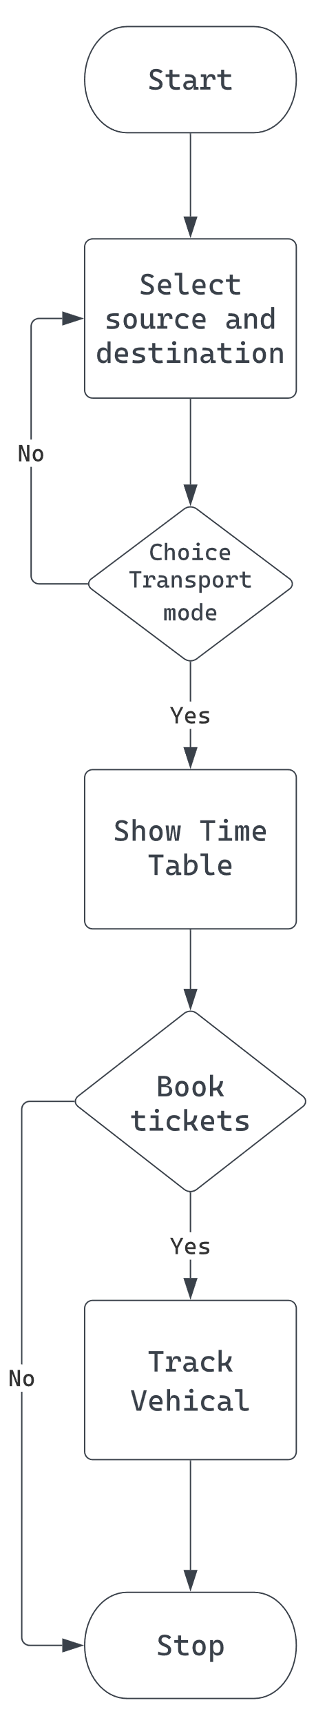
Proposed System

Slide 6
Objective
Main objectives of our proposed system are as follows
Developing a React Native application is the objective of this project.
The purpose of this service is to provide users with online and offline timetables for public transport buses and trains.
Provide users with the ability to book tickets using the application

Slide 7
Literature Survey
Sr.No. | Year | Title | Methodology Used
1 | 2008 | Noppadol Chadil, Apirak Russameesawang: real-Time Tracking Management System Using GPS, GPRS and Google Earth. | Due to the high cost of fossil-based energy, several methods are proposed to reduce the usage of the energy in logistics and fleet management to be even more. GPS tracking system is a common approach to get vehicle location information in real-time for fleet planning.
2 | 2011 | Mohammad A. Al-Khedher: Integrated GPS-GSM system is proposed to track vehicles using Google Earth application | An integrated GPS-GSM system is proposed to track vehicles using Google Earth application. The remote module has a GPS mounted on the moving vehicle to identify its current position, and to be transferred by GSM with other parameters acquired by the automobile’s data port as an SMS to a recipient station.

Slide 8
Literature Survey
Sr.No. | Year | Title | Methodology Used
3 | 2018 | Sanam Kazi , Murtuza BagasrawalaFarheen Shaikh, Anamta Sayyed: Smart E-Ticketing System for Public Transport Bus. | Buses are an integral means of public transport in India. In metropolitan cities like Mumbai and Delhi, 10-15 million people travel through public transport buses daily. Today, in the era of Digital India (a campaign launched by the Government of India) and Cashless Economy, public transport needs to adapt the technology advancement

Slide 9
Literature Survey
Sr. No. | Year | Title | Methodology Used
4 | 2019 | Shubham Jain, Adarsh Trivedi, Shweta Sharma: Application Based Bus Tracking System. | This research is based on Bus Tracking System, The main objective of this work is to make a GPS tracking application which would be able to track school buses more accurately and efficiently than present bus-tracking systems. We got the motivation for our research paper by observing how much precious time of the students studying in our college is wasted by just waiting for the bus on their particular route, and also there is a lack of information for the buses which are traveling on their particular route for the students who have already missed their particular bus.

Slide 10
Literature Survey
Sr.No. | Year | Title | Description
5 | 2020 | Ayman R. Mohammed: UML Modeling of Online Public Bus Reservation System in Egypt. | Designing a proper public transportation system is a main concern for many countries with large population size like Egypt. Therefore, the online based transportation business for individuals is highly growing in Egypt and the concept of online reservation in the transportation field has arisen. In this paper, a model in the analysis phase for an online public bus reservation system (OPBRS) is proposed
6 | 2021 | Prof. M. Chavan: Online Bus Reservation System. | Bus reservation system deals with maintenance of records of details of each passenger. It also includes maintenance of information like schedule and details of each bus. We observed the working of the Bus reservation system and after going through it, we get to know that there are many operations, which they have to do manually. It takes a lot of time and causing many errors while data entry. Due to this, sometimes a lot of problems occur and they were facing many disputes with customers. To solve the above problem, and further maintaining records of passenger details, seat availability, price per seat, bill generation and other things, we are offering this proposal of computerized reservation system.

Slide 11
UML Diagrams -
Structural Diagrams -
1. Class Diagram
2. Object Diagram
3.Component Diagram
4. Deployment Diagram
5. Package Diagram
Behavioral Diagram -
1. State Machine Diagram
2. Use case Diagram
3. Sequence Diagram

Slide 12
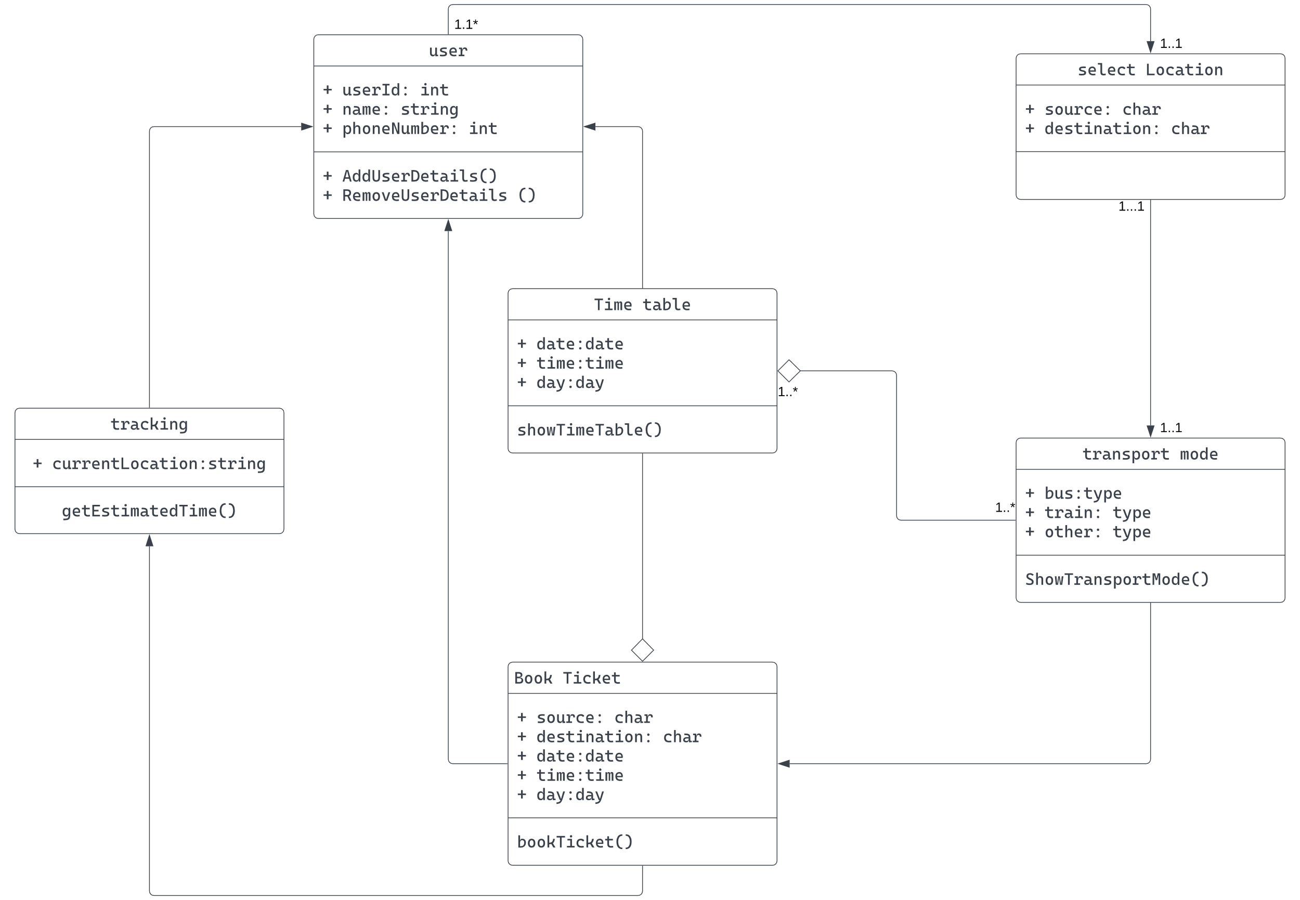


Slide 13
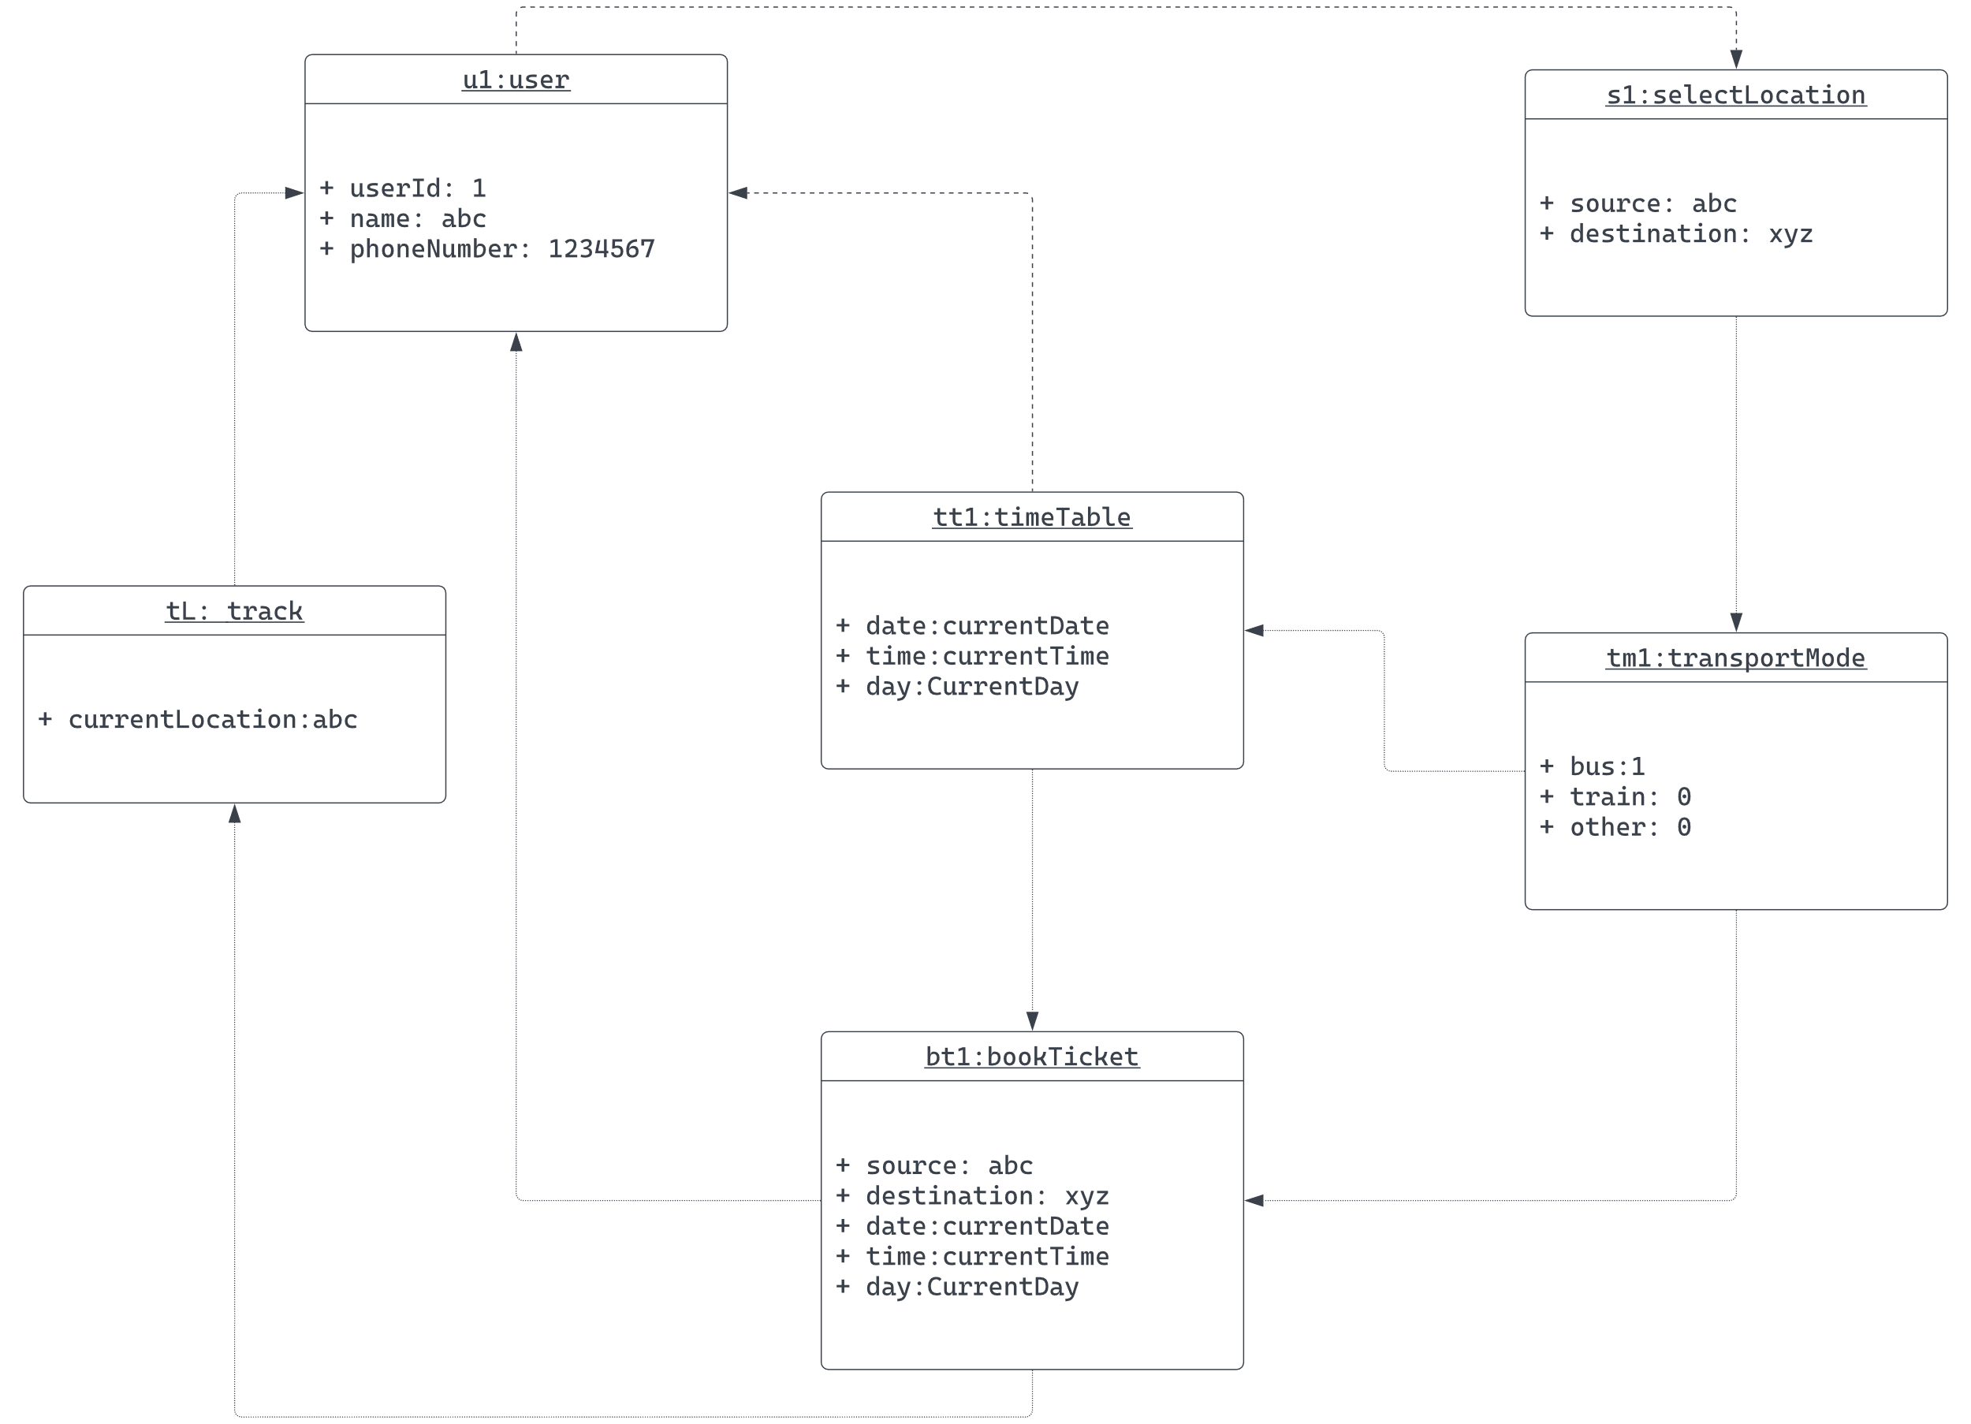


Slide 14
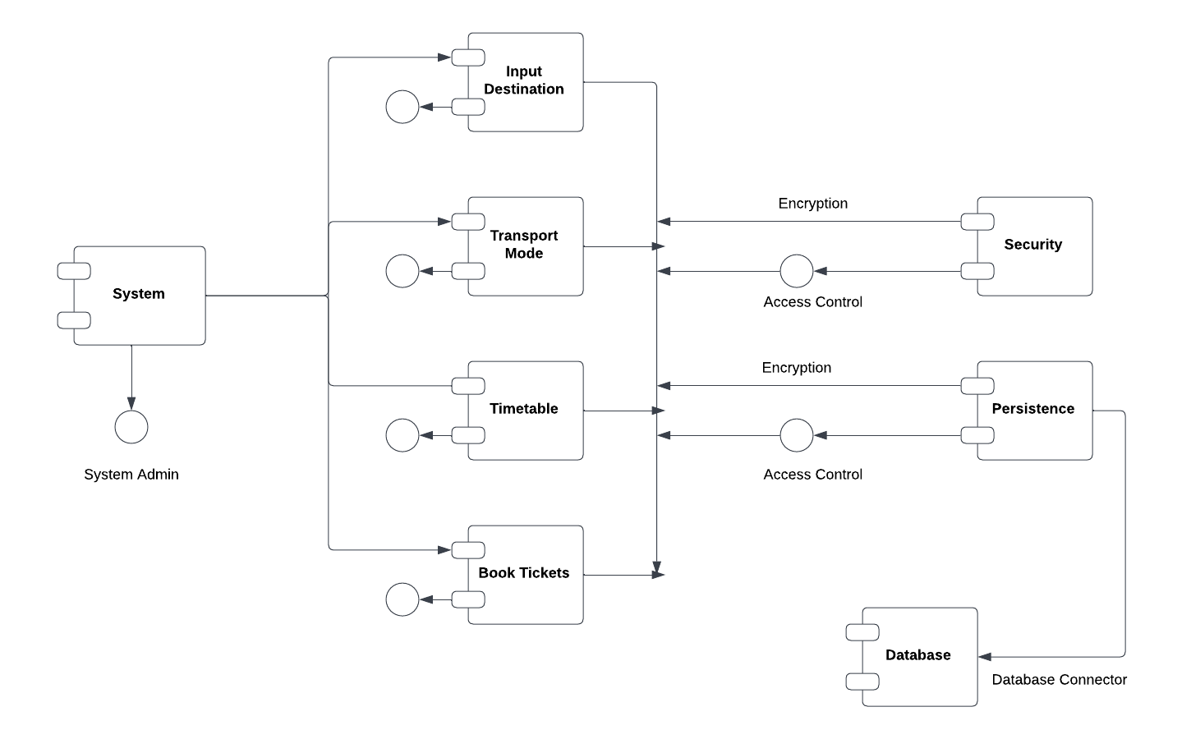
Component Diagram

Slide 15
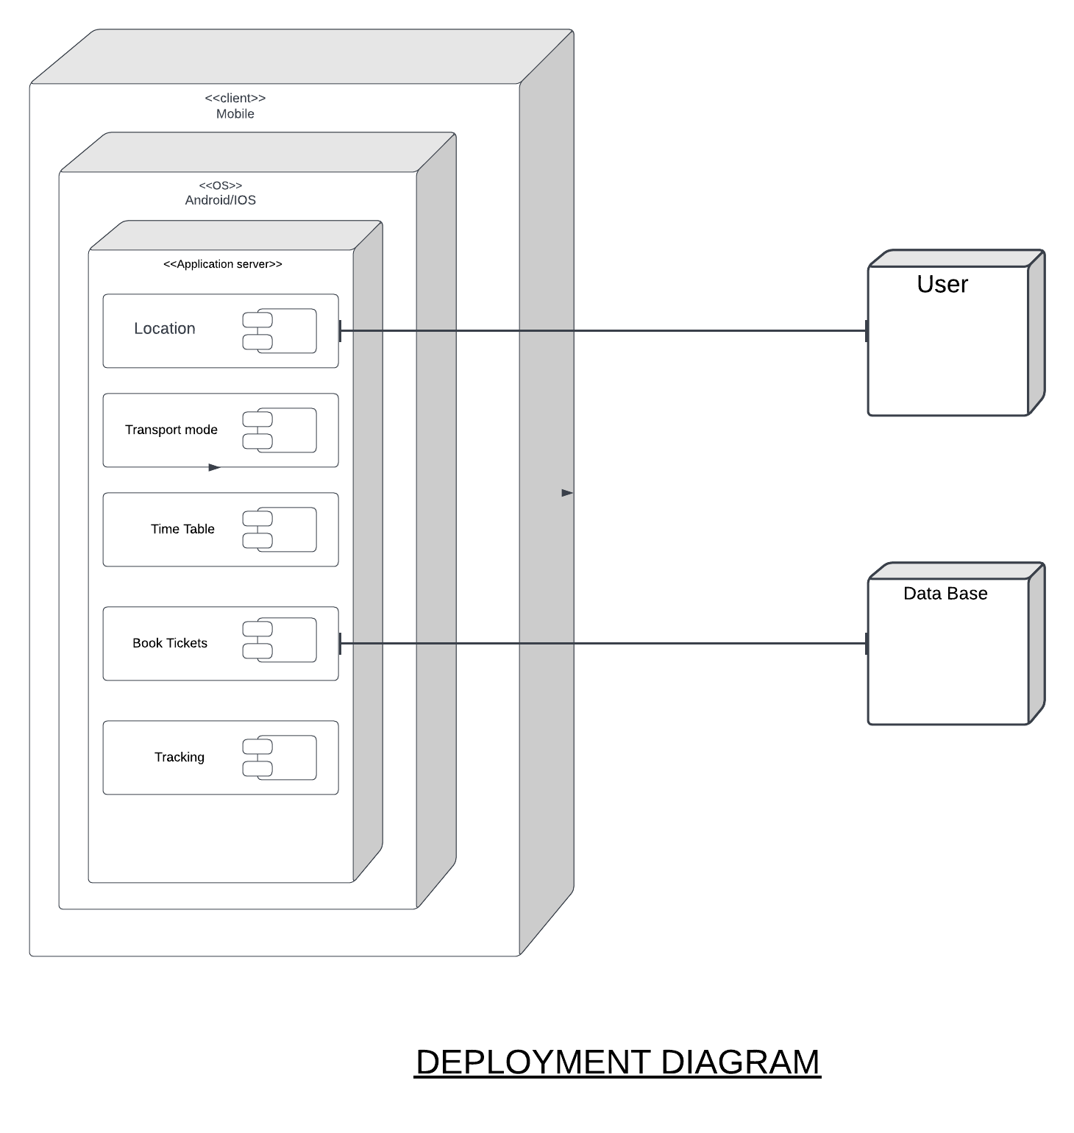


Slide 16
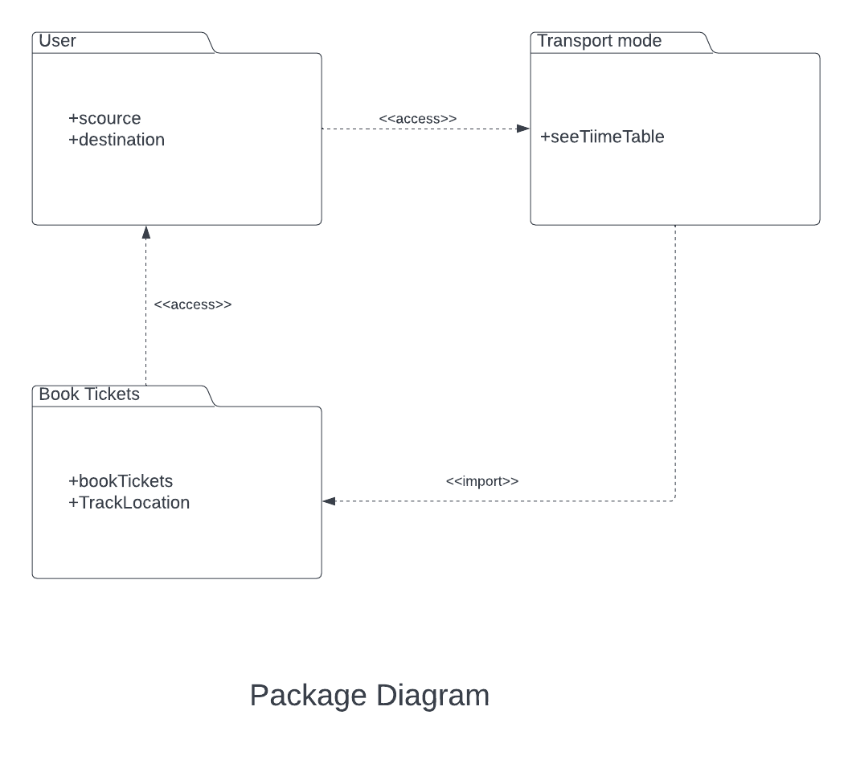


Slide 17
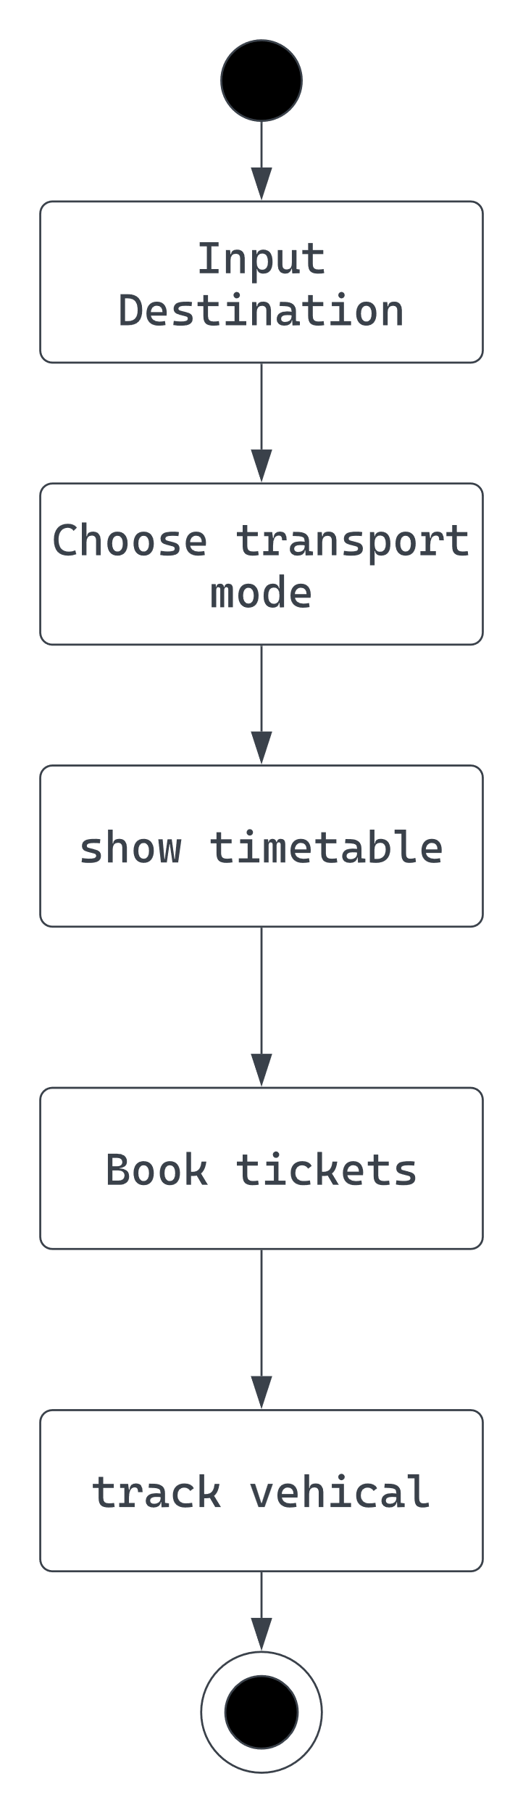
State Chart

Slide 18
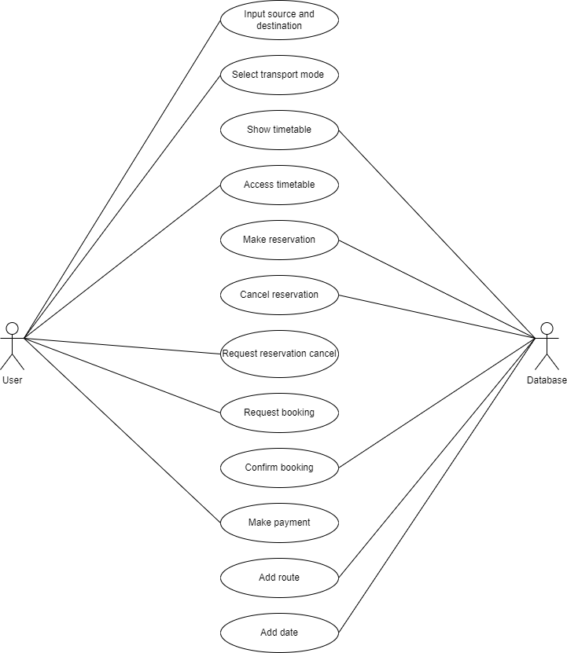
Use case diagram

Slide 19
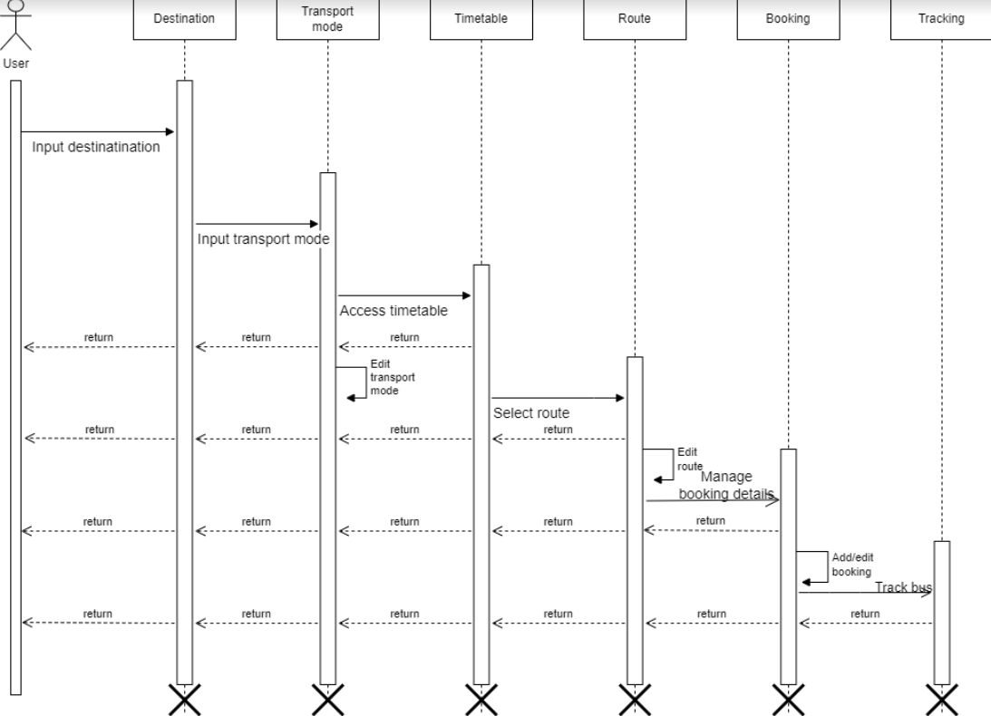


Slide 20
DFD Diagrams -
0-LEVEL DFD
1-LEVEL DFD
2-LEVEL DFD

Slide 21
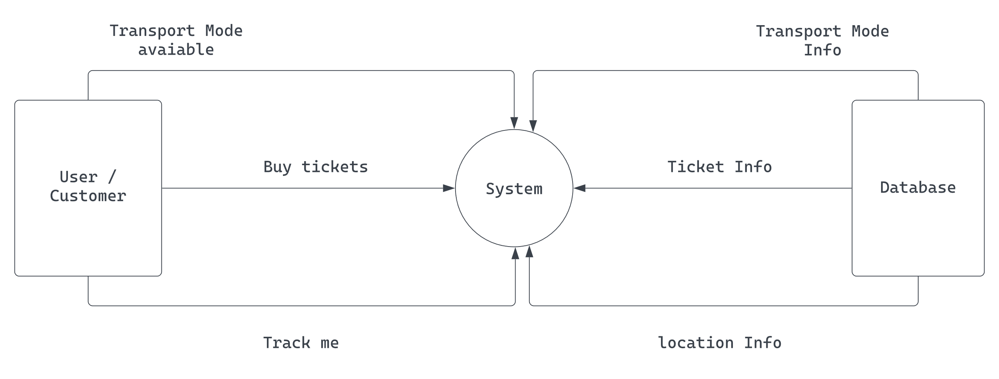


Slide 22
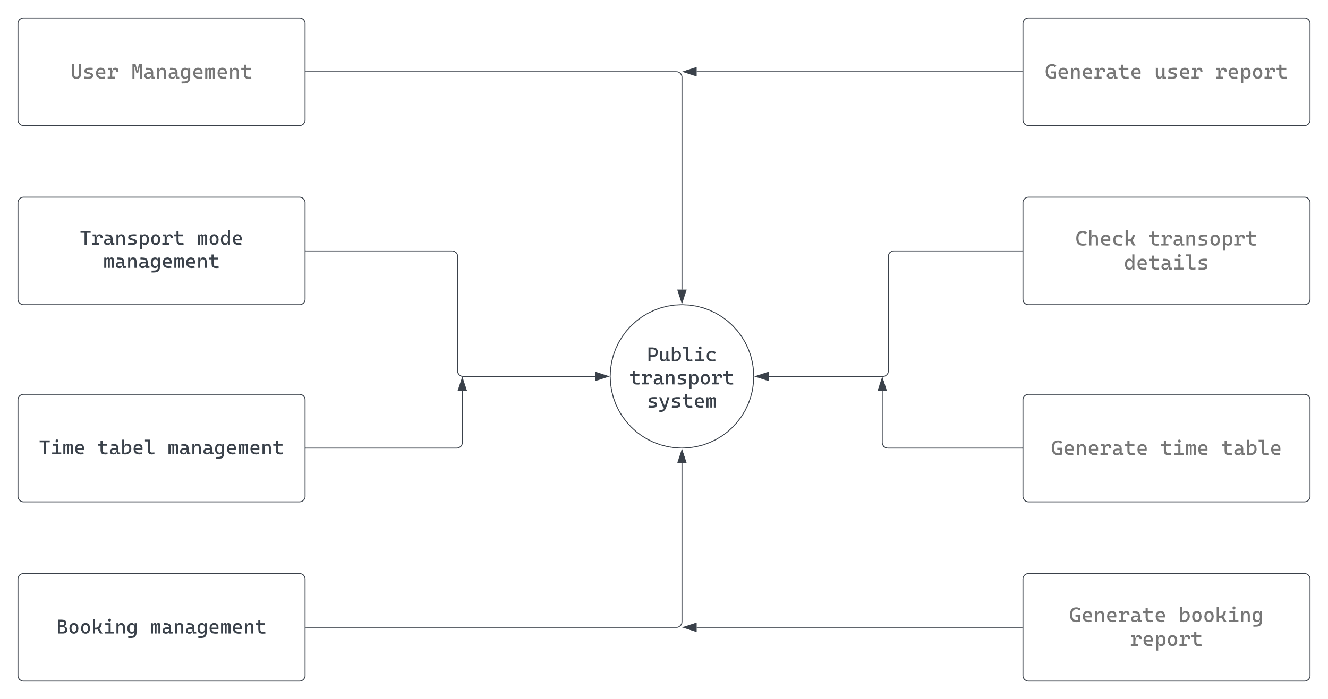


Slide 23
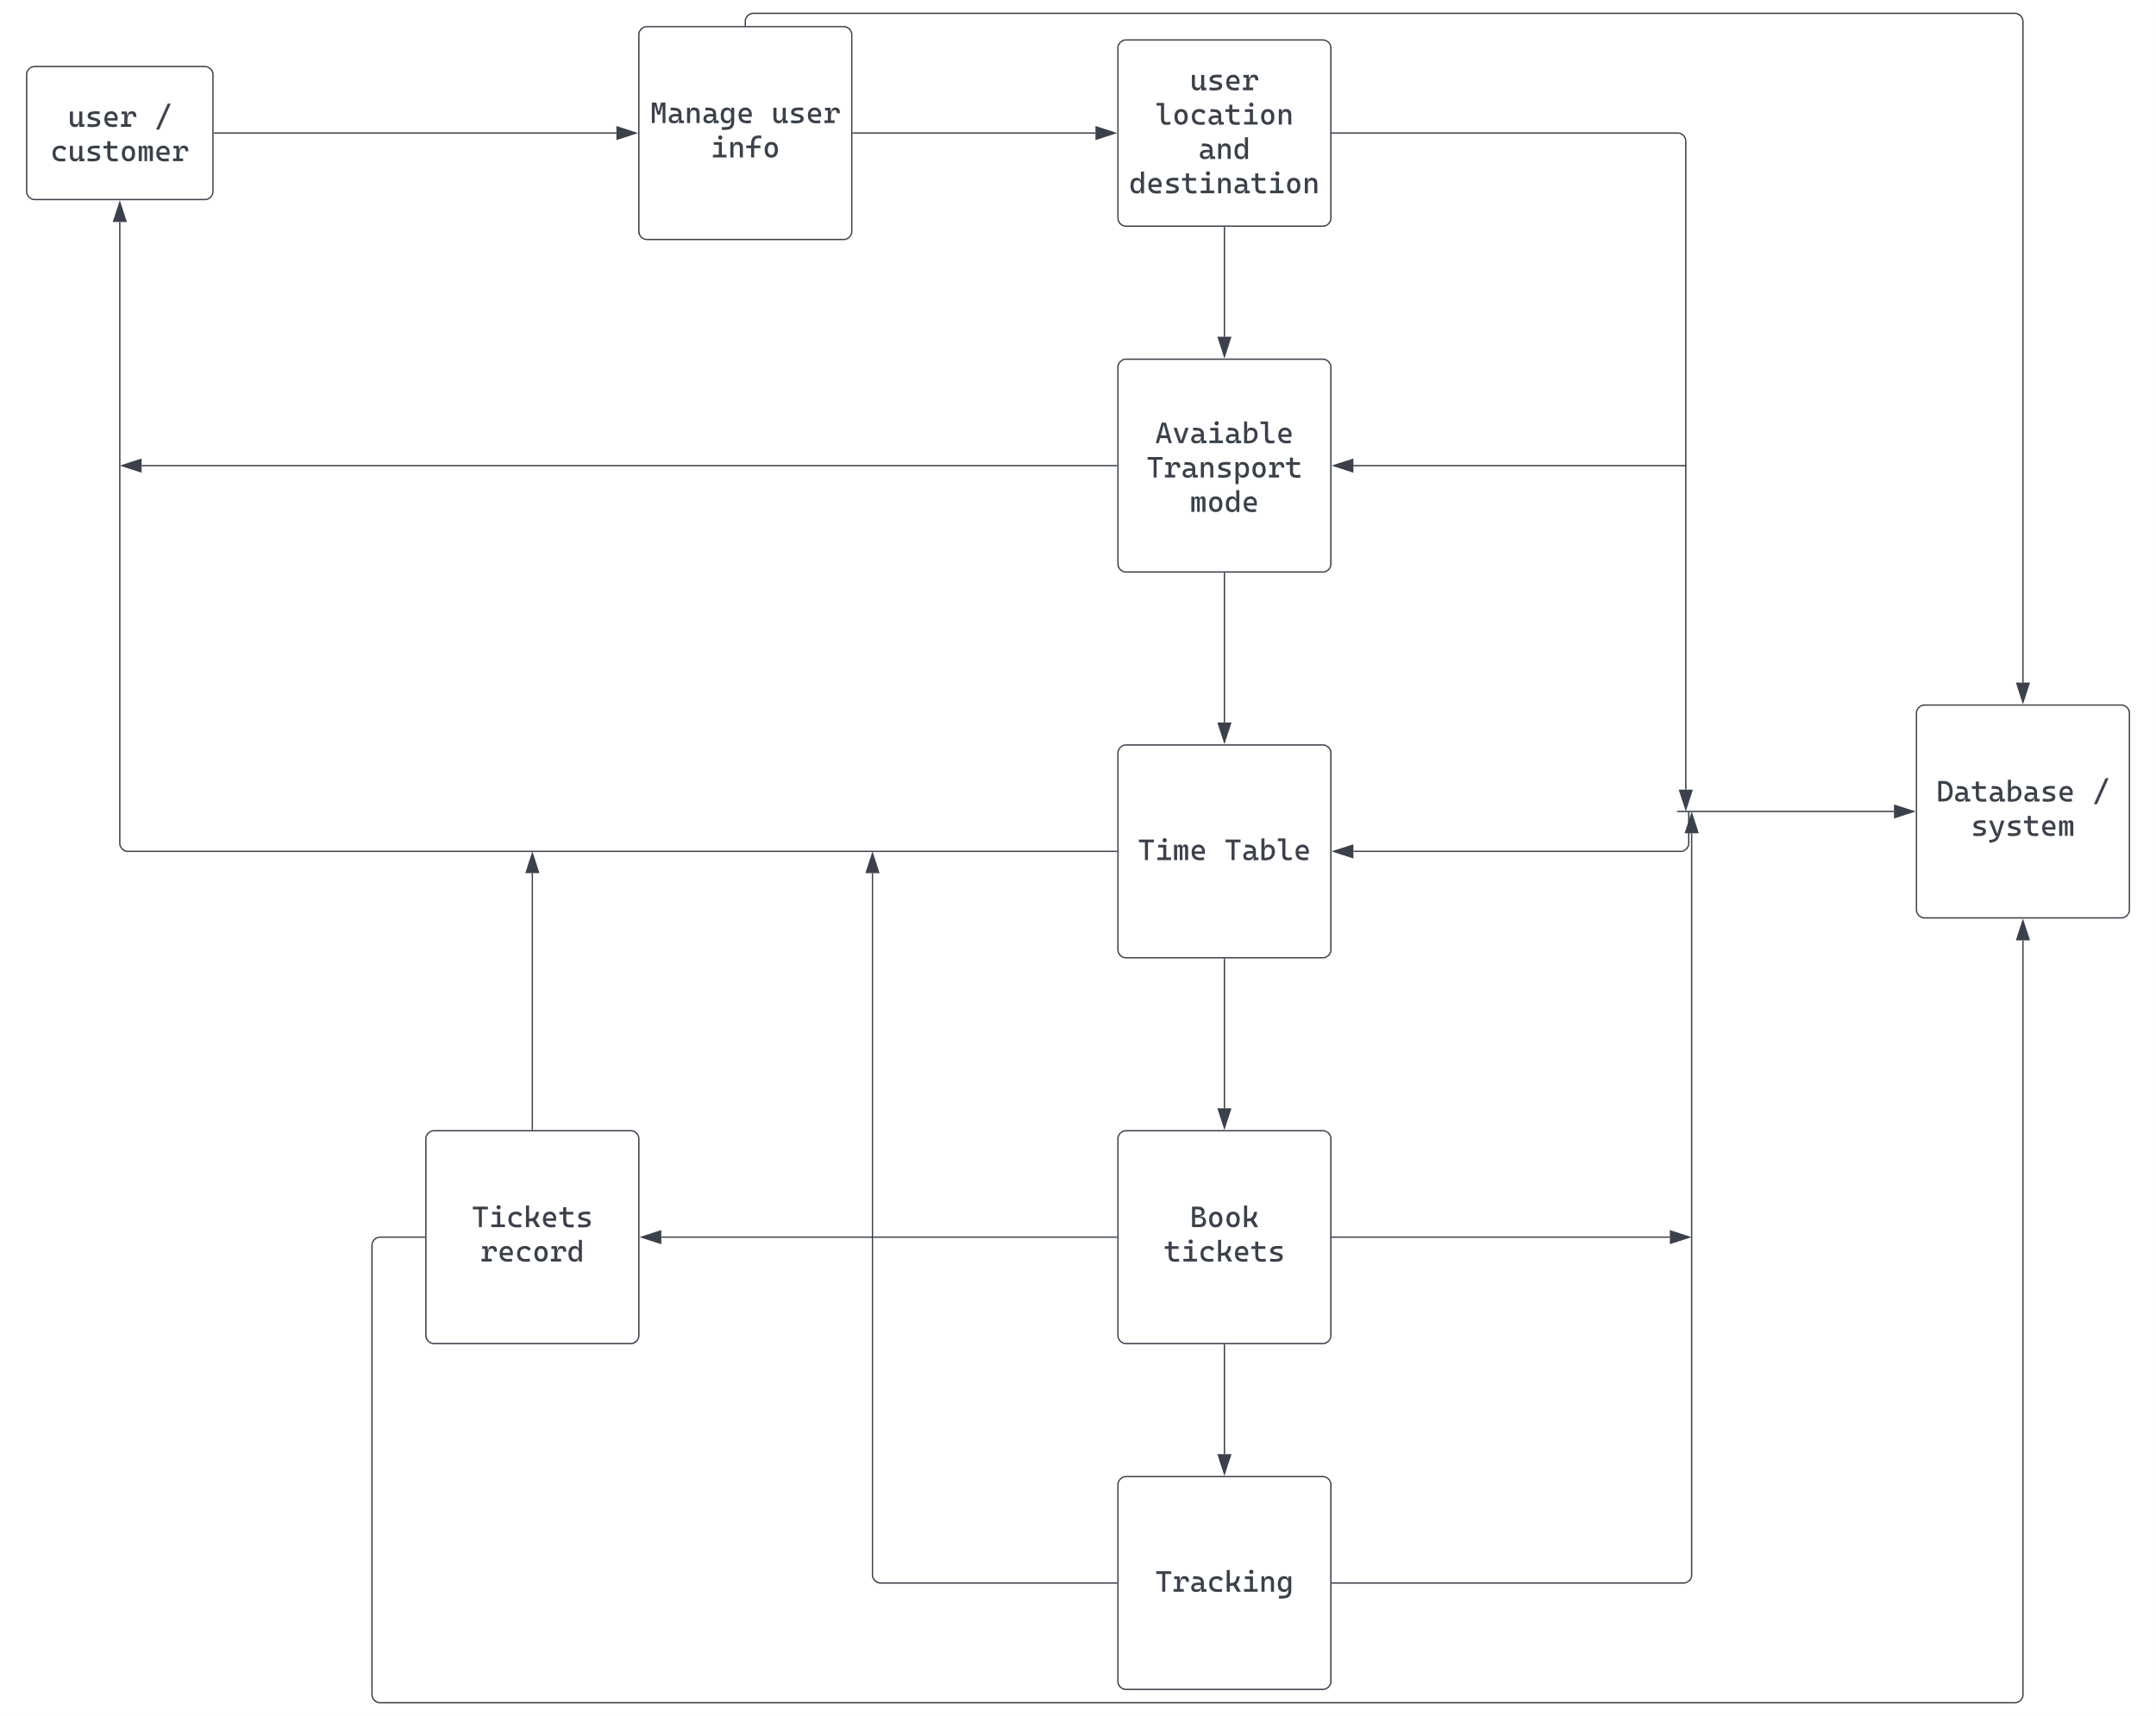


Slide 24
Conclusion:
As a result of our React Native based system, we conclude our system is better most of the application present currently since it doesn’t require connectivity to use the basic features of the application users are provided with a platform where they can locate local bus and train stations, as well as offline timetables and transport tracking systems. This system is intended to help people from remote locations and save them time.

Slide 25
References
Chadil, Noppadol, Apirak Russameesawang, and Keeratiwintakorn. Real-Time Tracking Management System Using GPS, GPRS and Google Earth, In IEEE 5th International Conference on Electrical Engineering/Electronics, Computer, Telecommunications and Information Technology, vol. 1,2008.
Mohammad A. Al-Khedher, “Hybrid GPS-GSM Localization of Automobile Tracking system”, International Journal of Computer Science & Information Technology (IJCSIT) Vol 3, No 6, Dec 2011.
Sanam Kazi , Murtuza BagasrawalaFarheen Shaikh, Anamta Sayyed Smart E-Ticketing System for Public Transport Bus - ©2018 IEEE.
Shubham Jain, Adarsh Trivedi, Shweta Sharma, Bus Tracking System – ©2019 IEEE.
Ayman R. Mohammed: UML Modeling of Online Public Bus Reservation System in Egypt - ©2020 IEEE.
Prof. M. Chavan, Navarange Prajwal, More Vishal, Nagargoje Shubham [7] proposed Online Bus Reservation System.

Slide 26
References
Android Studio [en.wikipedia.org]
Java [en.wikipedia.org]
Firebase [en.wikipedia.org]
React native [en.wikipedia.org]

Slide 27


